Slide 1

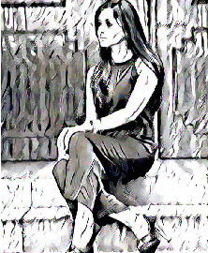
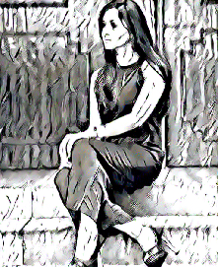
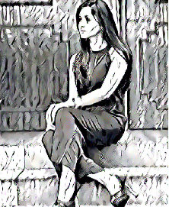
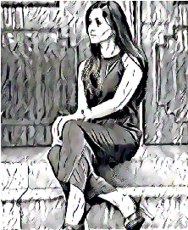
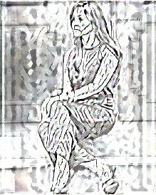
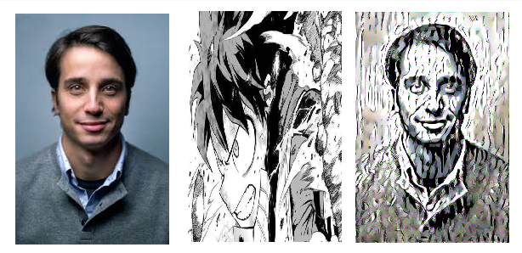
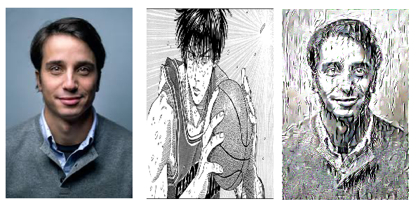
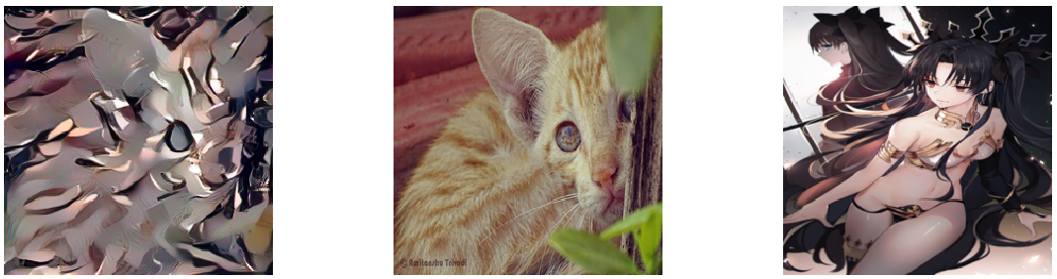
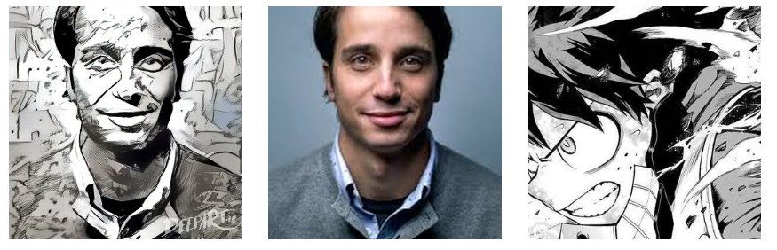
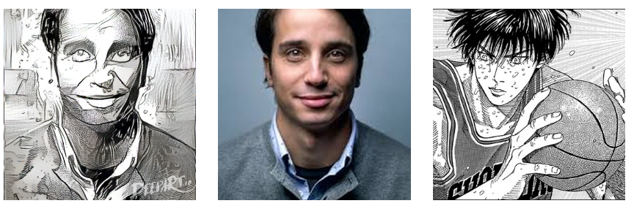
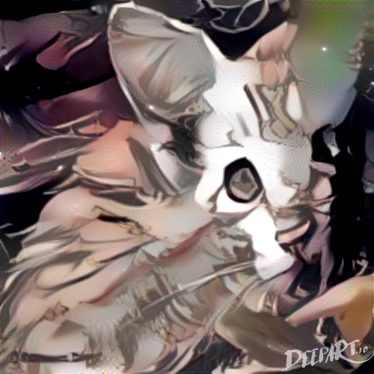
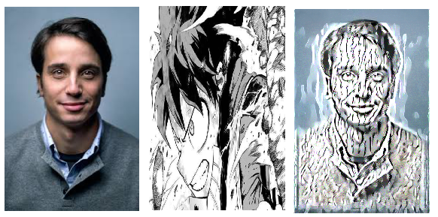
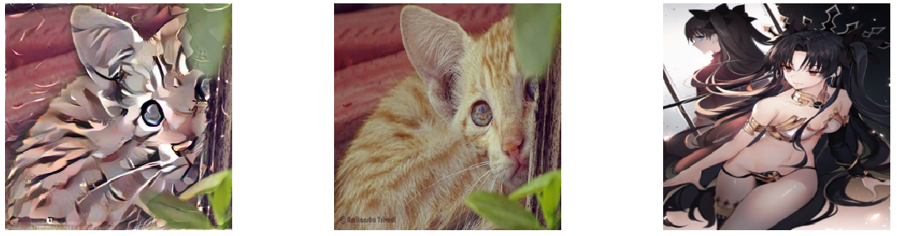
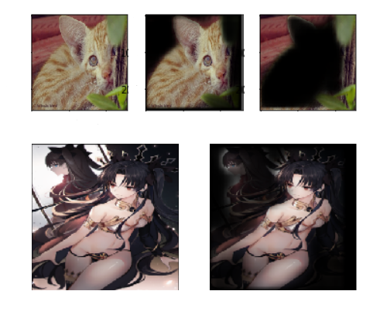
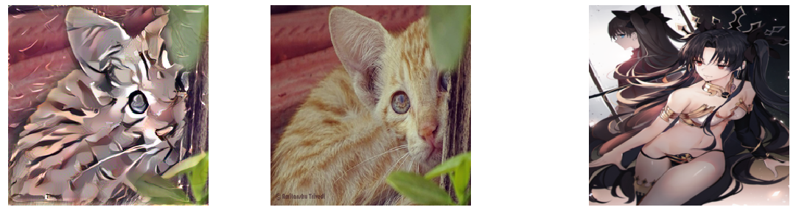
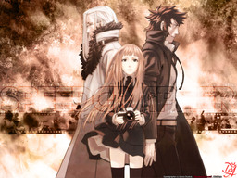
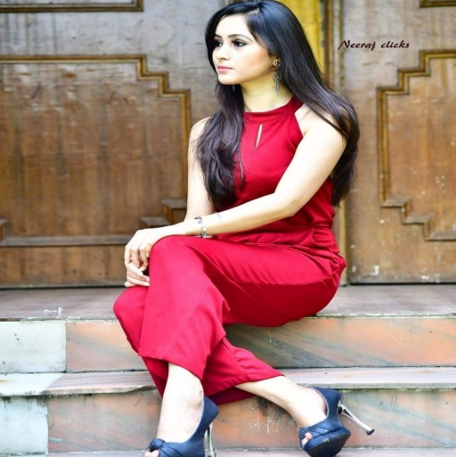
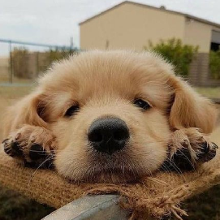
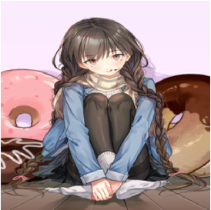
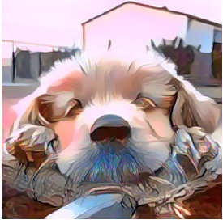

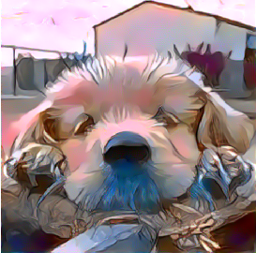

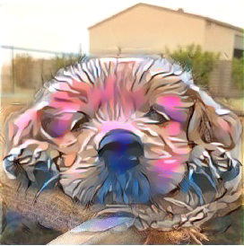
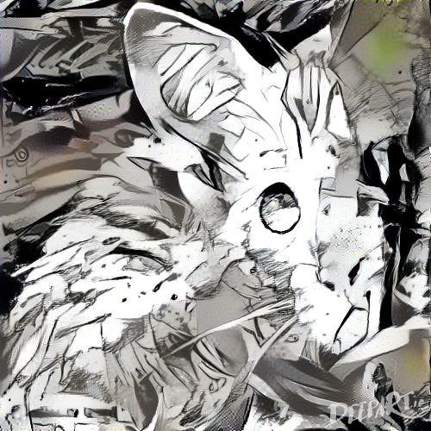
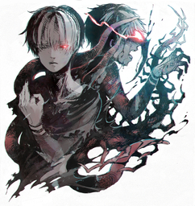
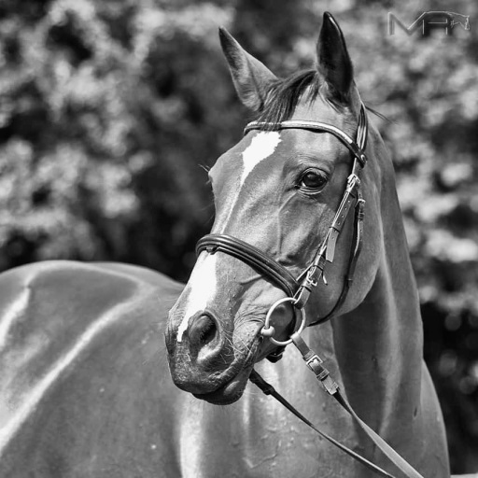
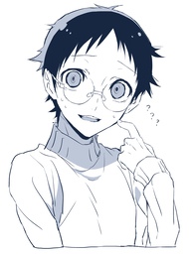
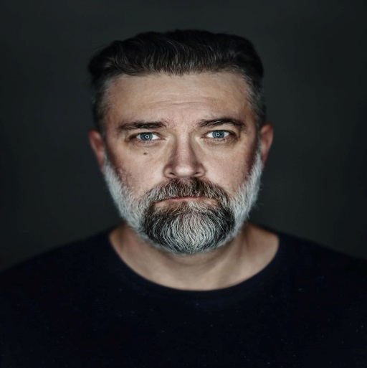
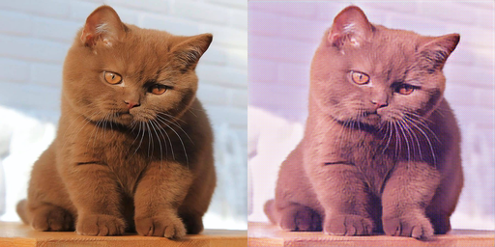
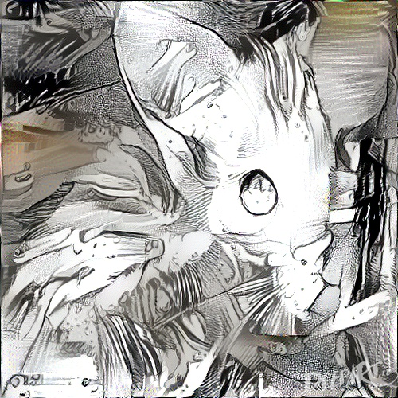
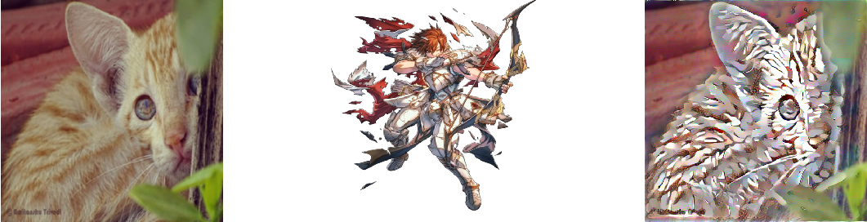

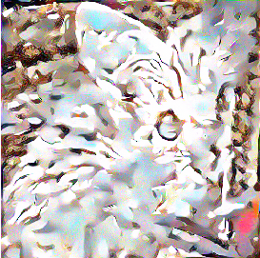
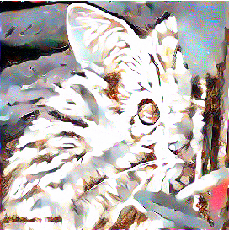
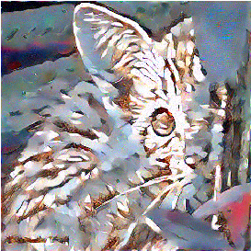
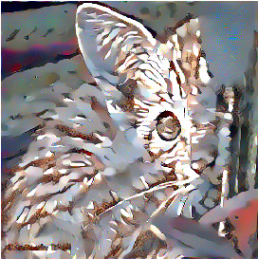
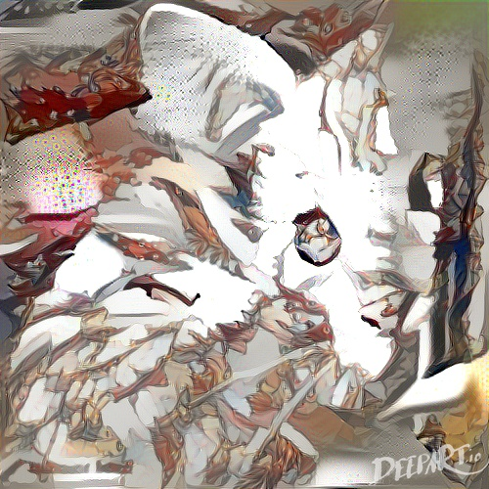
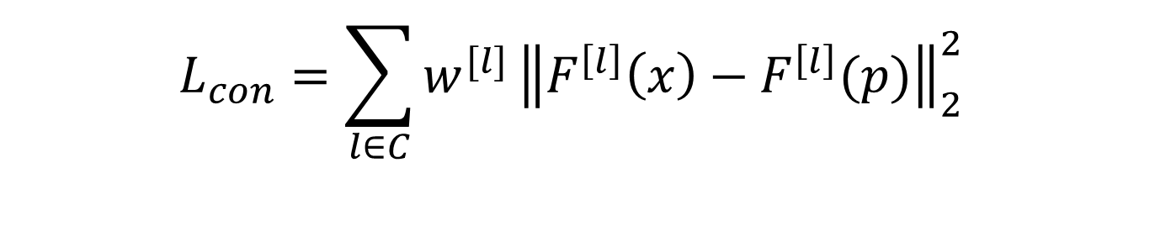
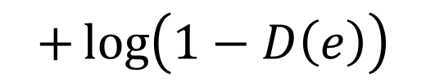
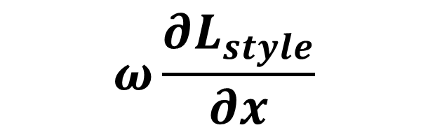

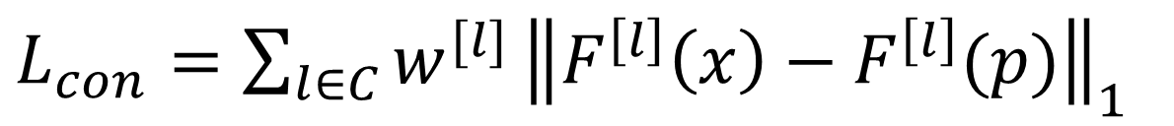
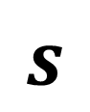
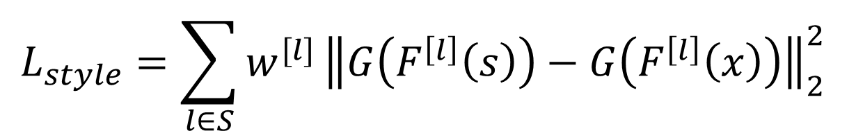

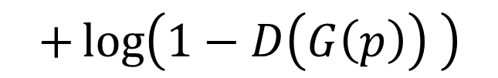
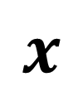


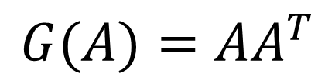
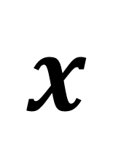

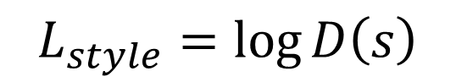

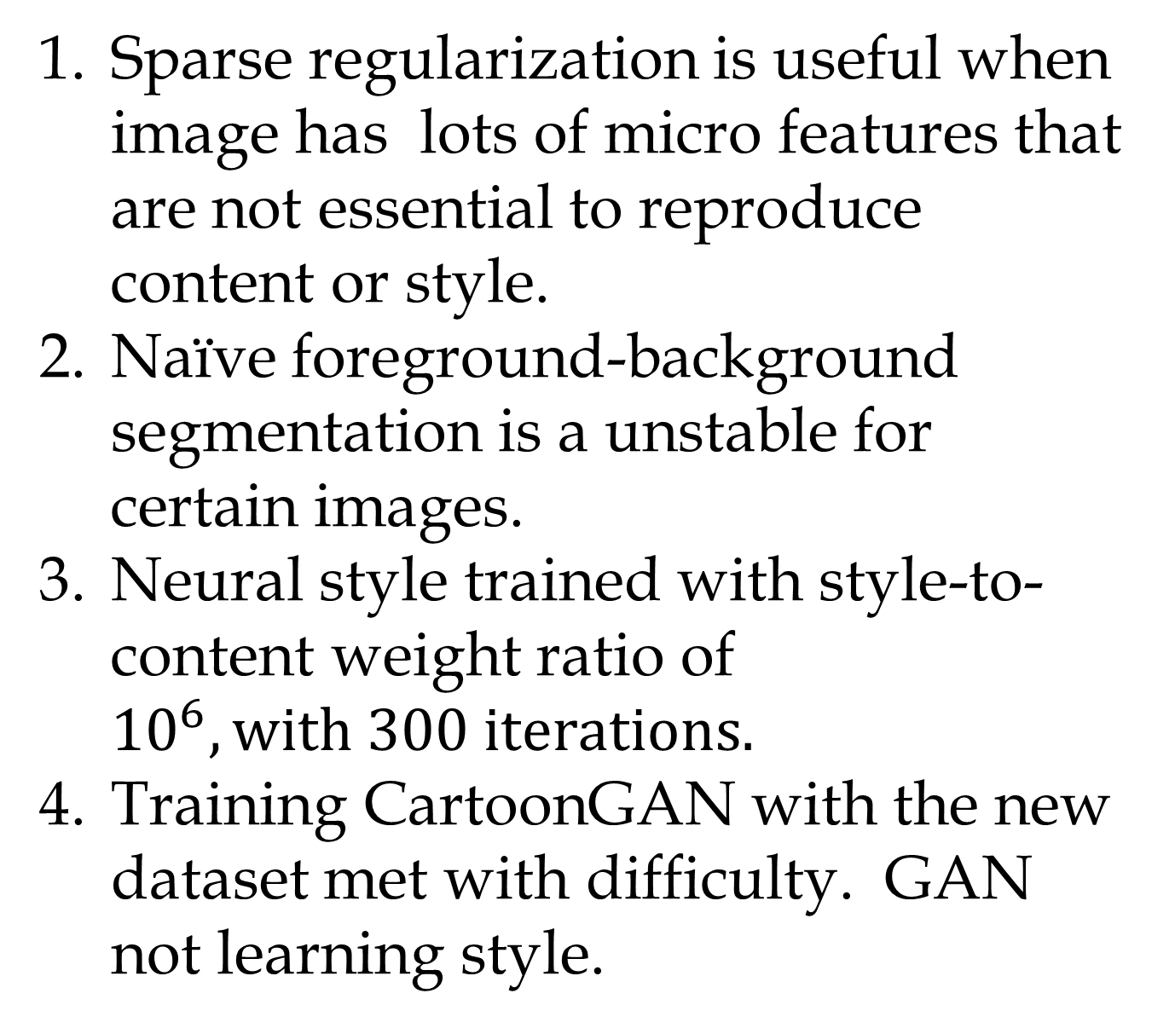
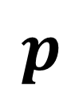

Manga Neural Style Transfer
Tun Sheng Tan
Motivation
Neural Style Transfer
Discussion
Neural Style
Content: L2
Style: L2
This work
Content: L1
Style: L2
This work
Content: L2
Style: L1
This work
Content: L1
Style: L1
This work with Mask-RCNN
Content: L1
Style: L1
Style
Gatys et al neural style transfer is the standard for style transfer using neural network. But it does not preserve edges especially on the foreground well.
Generate image $x$ that merges the features of image $p$ with the style of image $s$.
VGG-19 feature maps $F^{\left[l\right]}$ are used.
Sparse regularization is useful when image has lots of micro features that are not essential to reproduce content or style.
Naïve foreground-background segmentation is a unstable for certain images.
Neural style trained with style-to-content weight ratio of ${10}^{6}, with 300 iterations.$
Training CartoonGAN with the new dataset met with difficulty. GAN not learning style.
$$\frac{∂L_{con}}{∂x}$$
$$L_{con}=\sum_{l∈C}{w^{[l]}}{\left\|F^{\left[l\right]}\left(x\right)−F^{\left[l\right]}(p)\right\|}_{2}^{2}$$
Content loss
$$p$$
Baseline
Problem Statement
$$VGG19$$
$$x$$
$$x$$
$$Conv 1$$
$$Conv 5$$
$$Conv 2$$
$$Conv 3$$
The goal of our project is to attempt neural style approach and GAN approach that preserves edges.
Improve on neural style transfer.
Create a manga style database with about 5000 images for CartoonGAN.
$$Conv 4$$
$$s$$
Style loss
$$L_{style}=\sum_{l∈S}{w^{[l]}}{\left\|G\left(F^{\left[l\right]}\left(s\right)\right)−G\left(F^{\left[l\right]}\left(x\right)\right)\right\|}_{2}^{2}$$
$$ω\frac{∂L_{style}}{∂x}$$
DeepArt
$$G(A)=AA^{T}$$
Proposed Modification To Neural Style Transfer
Future Plans
1. Content loss with L1 loss
3. Use Mask-RCNN for targeted style
transfer
Add multi-scale segmentation style transfer.
Implement high-resolution style transfer.
Train CartoonGAN with the new dataset (not working at the moment)
Datasets
This work
$L_{con}=\sum_{l∈C}{w^{[l]}}{\left\|F^{\left[l\right]}\left(x\right)−F^{\left[l\right]}(p)\right\|}_{1}^{}$
Dataset consists 256x256 images scrapped by us.
4200 style images are scrapped from anime-pictures.net
4200 content images are scrapped from Instagram.
2. Style loss with L1 loss
$L_{style}=\sum_{l∈S}{w^{[l]}}{\left\|G\left(F^{\left[l\right]}\left(s\right)\right)−G\left(F^{\left[l\right]}\left(x\right)\right)\right\|}_{1}^{}$
Style Images
Content Images
Result
Mask-RCNN
CartoonGAN
Training Details:
Pre-trained G to reproduce image
Pre-trained D to classify style image from content and blur style image
Batch size: 10 (Memory limited)
Same learning rate for D and G
Tried different style database
$$L_{style}=\log{D\left(s\right)}$$
$$+\log\left(1−D\left(e\right)\right)$$
Generator (G)
$$+\log\left(1−D\left(G\left(p\right)\right) \right)$$
Discriminator (D)
References
Gatys et al. A Neural Algorithm of Artistic Style arxiv:1508.06576
Chen et al , CartoonGAN arxiv:1904.13268
He et al Mask R-CNN arxiv:1703.06870
Content Image
Style Image
Content: L2
Style: L2
Content: L1
Style: L2
Content: L2
Style: L1
Content: L1
Style: L1
Content: L1
Style: L1

